Slide 1
Social Hour
Project Development Proposal

Slide 2
Member Roles
Michael Rinehart - Project Manager, Android Developer
Dylan Zeller - Android Developer, Database Manager
Rocco Ordille - User Testing, Database Manager
Gavin Sentak - Database Manager, Data Scientist

Slide 3
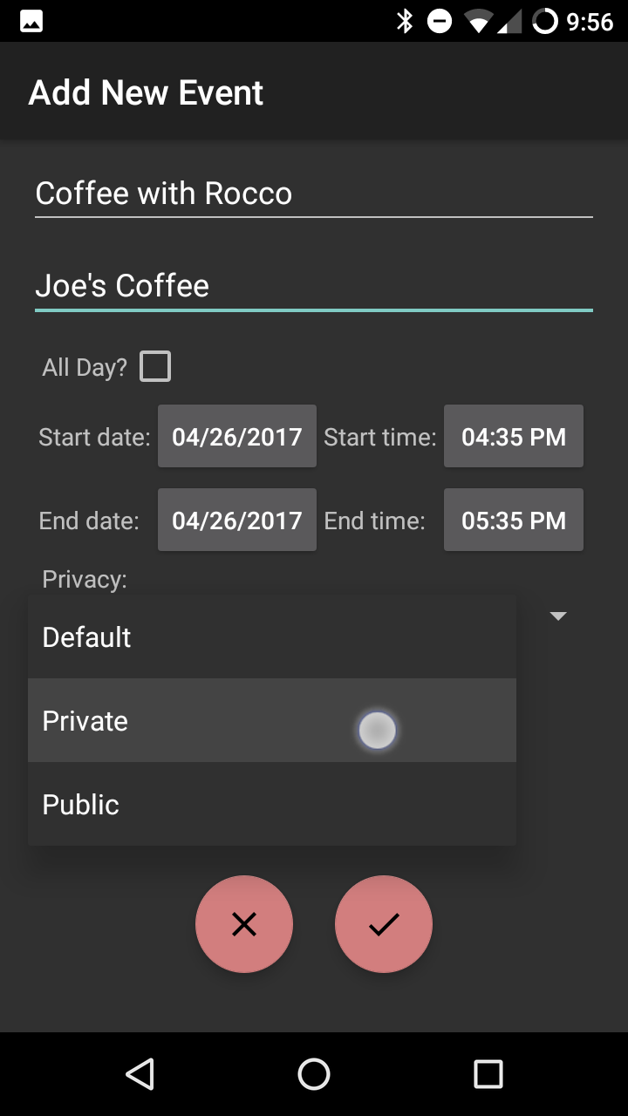
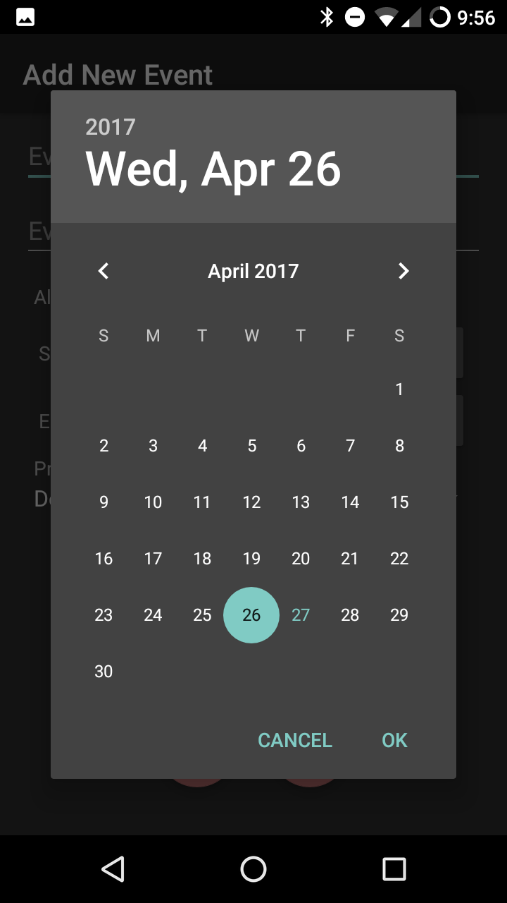
Social Hour Overview
Social network based on Google Calendar
Augments calendar with social network capabilities, bridging gap between availability and scheduling
Current target: university students
Business plan:
user testing info helps team target platform features to users
expose gaps in current networks
We are meeting our plan by conducting testing and scheduling meeting times
Notes:
Progress is moving along as planned and hopefully it continues

Slide 4
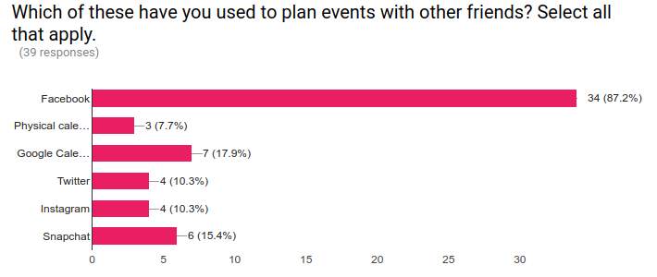
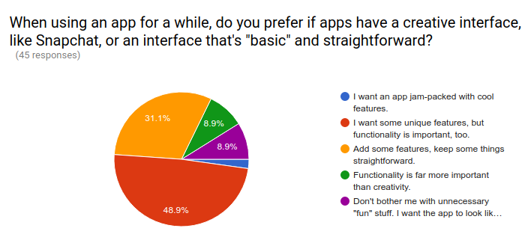
User Testing
Notes:
Distributed questionnaires earlier this week, received valuable feedback from potential users
for user design, a majority said they want some unique features, but functionality is very important as well
Facebook was overwhelmingly popular for planning events with friends compared to other social networks

Slide 5
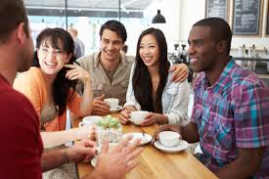

Project Motivation
Wanted a social network that seamlessly integrated with personal calendars
Augments social life rather than replacing real-life interaction
Notes:
Current social networks with event capabilities do not allow for easy transfer of events to calendars and vice versa
Scrolling isnt actually socializing, Promotes real life interactions and socializing

Slide 6

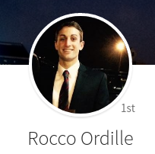
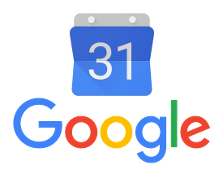
Scope of Effort (Level 1)
Google Firebase Integration
Creating User Groups
Adding Profile Pictures
Google Calendar Integration
Synchronizing Events
Calendar Interface
Friends and Groups
Notes:
Gavin

Slide 7
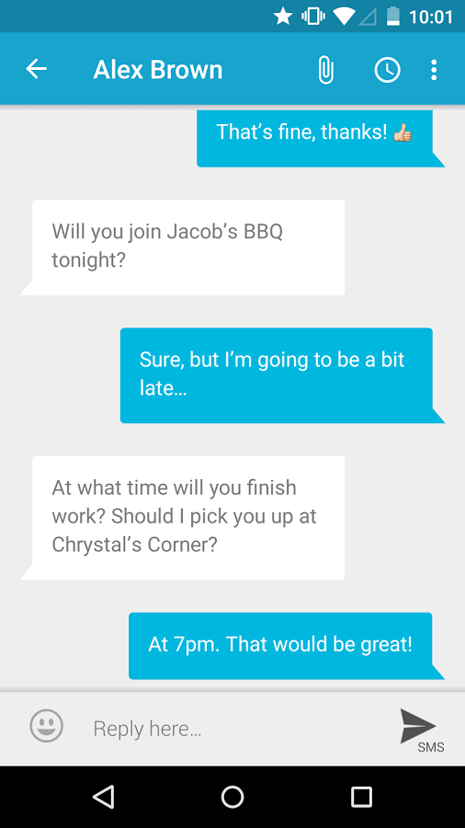
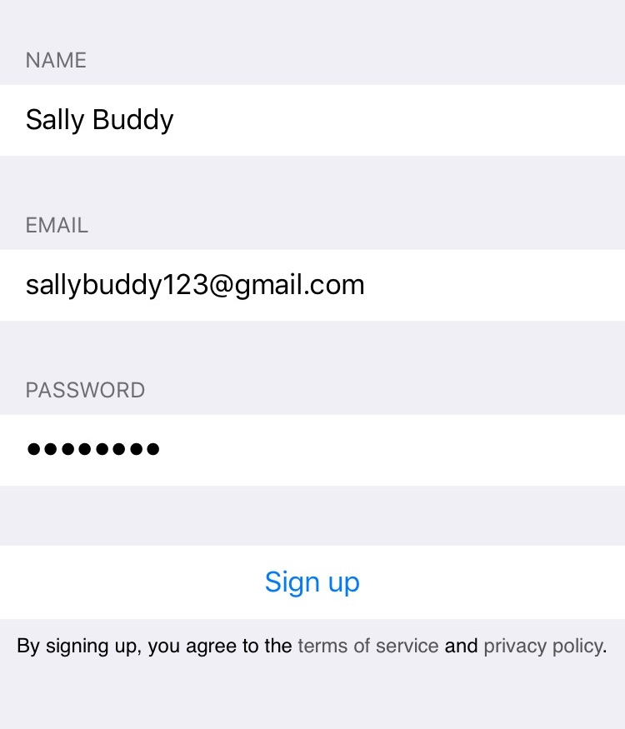
Scope of Effort (Level 2)
Non-Google Logins
Enter new design phase to properly implement account creation
Level 1 scope purely relies on Google
Peer-To-Peer Interactions
Firebase Messenger
Notes:
Gavin
Between lab terms firebase messenger was new feature cool to add for users

Slide 8

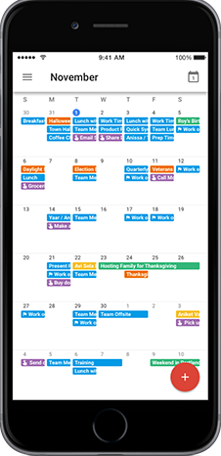
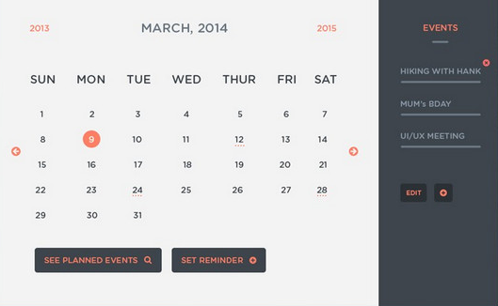
Scope of Effort (Level 3)
Expand Target Demographic Beyond Collegiate Life
Evaluation of user needs and feedback
Applications for the business sector
Develop iOS Application
Whole additional system design, library usage, and user interface
Implement Web Interface for the Desktop
Adapt Android design to web platform
Notes:
Michael Rinehart

Slide 9
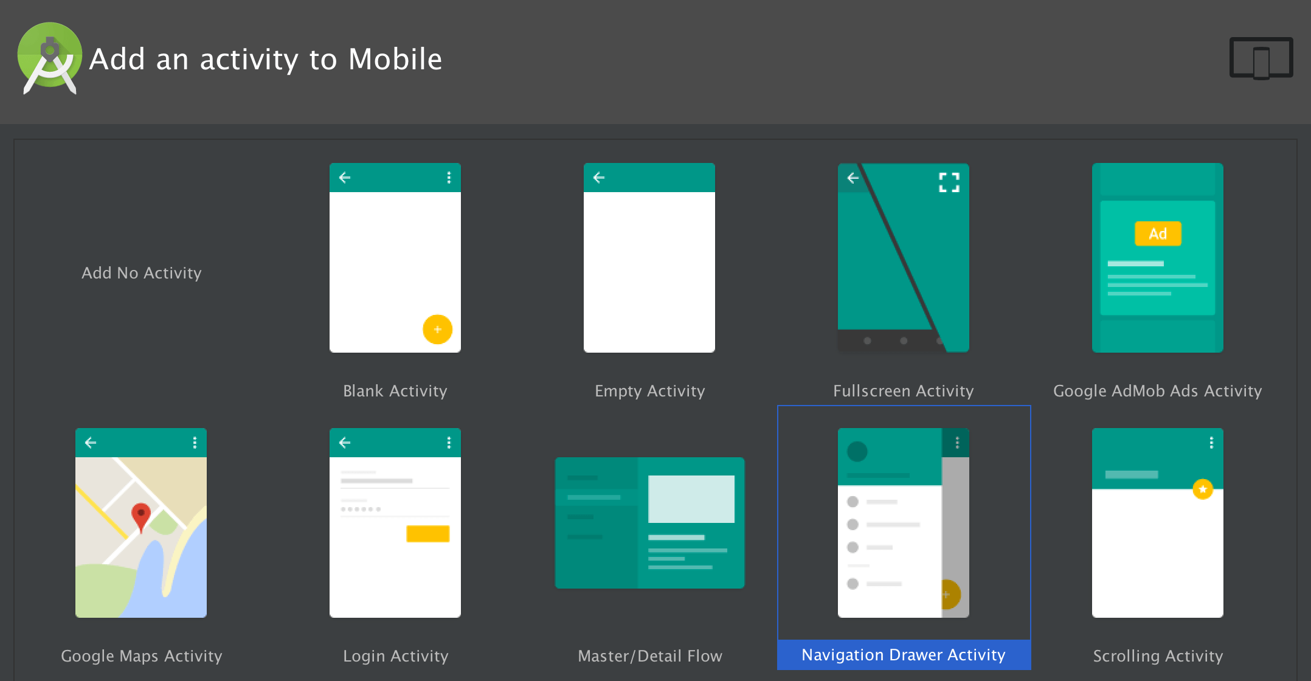

Lessons Learned
Firebase is a LOT easier to use than MongoDB
Heavy Google integration
Design libraries provided in Android Studio
Layouts
Material Design Guidelines
Component Testing helps integration testing go much more smoothly
Notes:
Michael Rinehart

Slide 10

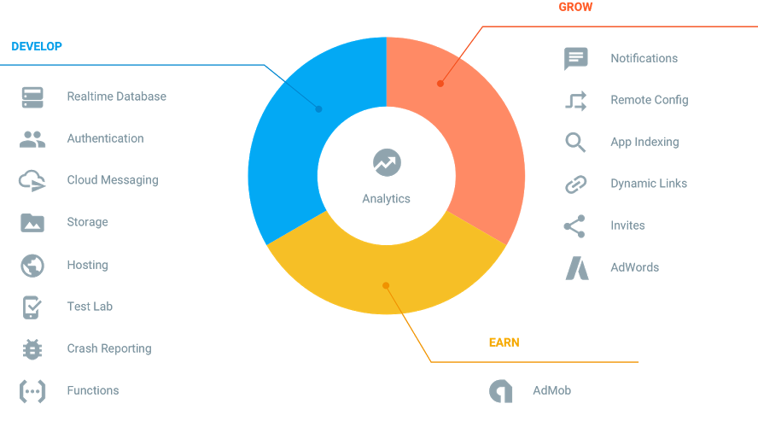
Major Deliverables
Android Application
Distribute working app version with features defined in Scope 1
Database
Implement Google Firebase to Social Hour
User Testing
Report of findings from feedback surveys and Google Analytics
Notes:
Michael Rinehart

Slide 11


Future Work Plan and Scheduling
Division of Goals
Goals Divided into 4 Major Categories
UX Design - Michael, Dylan
Java Development - Michael, Dylan
User Testing - Rocco
Database Implementation - Gavin
Future Planning
Weekly Task List
Formal Task List
Development Phase Test Plan
Notes:
41 requirements statements produced
37 issues in the formal issues list
Week 8 finished application
Dylan

Slide 12
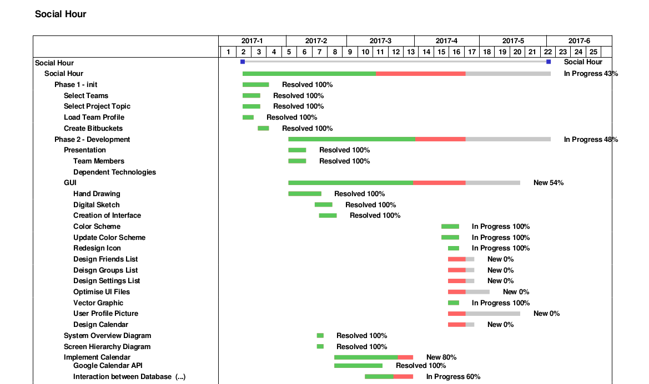
Gantt Chart, Part I
Notes:
All requirements are placed in our gantt chart
Progression of tasks such as ui design in chronological order
Major deadlines along the way, but finished design by week 8
Dylan

Slide 13
Gantt Chart, Part II
Notes:
Dylan

Slide 14


Conclusion
Currently on schedule to meet all planned deliverables
Team is motivated to complete Scope 3 after end of CI 103
Learned numerous lessons from research of user needs and technology implementation
Modified plans for user testing, library inclusion and database provider based on learned lessons from prototype
Notes:
Library inclusion = import statements and ui design
Motivated team

Slide 15
Sources
Picture of Rocco
https://lh3.googleusercontent.com/_gpQ5T1jLbbpyoaDHgYoJV_seHudPYAqfYe7me5MApKMYUuY91E_h6y3Jy_Cxe8OO8E=w300
Google Calendar Photo
https://storage.googleapis.com/gweb-uniblog-publish-prod/images/Calendar_on_iOS_week_and_month_view.width-2000.width-750.png
https://www.pinterest.com/pin/288652657338534338/
https://dcrazed.com/wp-content/uploads/2014/03/calendar-ui-event.jpg
https://storage.googleapis.com/gweb-uniblog-publish-prod/images/Calendar_on_iOS_week_and_month_view.width-2000.width-750.png
http://www.appcoda.com/wp-content/uploads/2016/11/firebase_logo_shot.png
https://pbs.twimg.com/media/CN6xRQNUAAA4zYI.png
https://lh3.googleusercontent.com/Y9NOQIyL06FESFLOyWvDoCIEUiGCx_2YxTbWKaAQbGSvdlikN4JOQlg3ovLVeiVh872hZzjiCH6jbOnNfzICY-C10PlJ3g=s888
https://www.google.com/url?sa=i&rct=j&q=&esrc=s&source=images&cd=&cad=rja&uact=8&ved=0ahUKEwjJxKzrksbTAhXKNiYKHTs6DxMQjRwIBw&url=https%3A%2F%2Fwww.cornerstone-group.com%2F2014%2F12%2F02%2Finspiration-coffee-cup%2F&psig=AFQjCNHJ-b5nAtWs2AlAgKlr-h3tx1ElnQ&ust=1493434373367093
http://totallysocial.files.wordpress.com/2011/10/facebook.jpg
https://justtempo.com/ccfit/app_instructions
https://katsized.files.wordpress.com/2013/08/business-man-holding-stopwatch.png

